Slide 1
Consensus Algorithms

Slide 2
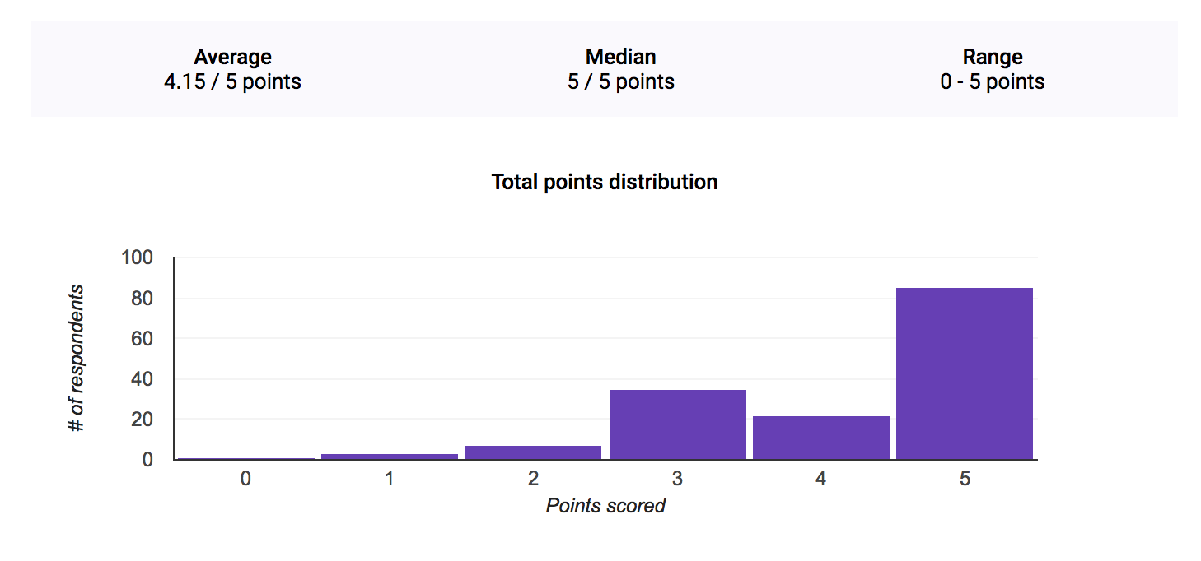
Administrivia
Quiz 2 grades/solutions released
HW2 released - due next Thursday!

Slide 3
Paxos
Citation: Google Tech Talks video on Paxos

Slide 4
Paxos
What do we mean by consensus?
Consensus is on one value.
Consensus is reached once a majority of participants agree.
Once a consensus is reached, everyone can eventually know the result.
Participants are happy to reach consensus on any result, not just the one they propose.
Communication channels are not perfect (messages may be lost).
Notes:
So for our purposes, we’re going to be talking about a particular definition of consensus.
In particular, we’re just going to be talking about consensus on a single “thing.” So for instance, this could be a decision amongst you and your friends about what restaurant to go to this evening, but it doesn’t involved a decision about what to order when you get there (although you could do another “round” of the decision making process on that… more on that later).
We’re also not going to worry about uniform consensus (where ALL parties agree) and instead go for a “majority rules” consensus like in an election. Uniform consensus is necessarily harder (and less fault tolerant) since it has stronger requirements on a decision being made. If you’re interested it’s another area of study you can look into, but we’re not going to cover it in this course.
Now, even though we’re sticking with majority consensus, it’s important that eventually all participants can find out what the majority decided.
It’s also important that participants are happy to reach consensus on any value, not necessarily just the one they propose. In other words, no “rage quitting” :)
And lastly (and sort of the point of why this is hard), we have to assume that communication channels are imperfect. This could mean that messages are lost because a connection is bad, or one of the machines goes down, etc.

Slide 5
Paxos
“Sure, Finding Nemo is great”
“What about Mission Impossible”
Bob
“Ugh, OK fine”
Charlie
“Let’s see Finding Nemo”
“Finding Nemooooooooo”
Alice
Debbie
Erica
“OK, I guess it’s Finding Nemo”

Slide 6
Paxos
“Sure, Finding Nemo is great”
“What about Mission Impossible”
Bob
“Ugh, OK fine”
Charlie
“Let’s see Finding Nemo”
“Finding Nemooooooooo”
Alice
Debbie
Fred
Erica
“Yes, Finding Nemo!”

Slide 7
Paxos
Paxos defines three different roles for the nodes in the system:
Proposers
These propose values for consensus.
Acceptors
These “vote” on proposals and form the majority.
Learners
These record whatever the acceptors have accepted as the decision.
Decisions must be persistent. Nodes must know how many acceptors there are.
Note: we’re talking about them separately, but in practice any single machine can play any number of roles simultaneously
Notes:
OK so for starters, we’re going to refer to all the participants in the Paxos algorithm as “nodes.” Paxos defines three different roles a node in the system can play. Proposers are responsible for proposing values for consensus, effectively kicking off a run of the algorithm. The acceptors are the machines that do the voting, and the learners essentially just record what the acceptors have decided on for the sake of redundancy/replication.
For explanation purposes we’re going to treat these as separate roles, but in practice any node can play many (or all) roles simultaneously.
Note that decisions must be persistent - if acceptors forget what they’ve committed to then the algorithm fails. It’s also important that the nodes all know how many acceptors there are so that they know when a majority decision has been reached.

Slide 8
Paxos
PREPARE 5
ACCEPT-REQUEST (5, ‘nemo’)
Proposer
Acceptors
PROMISE 5
ACCEPT (5, ‘nemo’)
Learners
Proposer picks a proposal ID (ID_{p}) and sends a PREPARE ID_{p} message to Acceptors
IDp must be unique (i.e. different proposers should pick different IDs)
Timeout? Pick higher ID_{p}
Proposer gets PROMISE response from majority of acceptors. It sends ACCEPT_REQUEST (ID_{p}, value) to Acceptors.
value can be anything
Acceptor receives ACCEPT_REQUST. Did it promise to ignore IDp?
If yes, then ignore request
If no, reply ACCEPT (ID_{p}, value) and also send to Learners
Acceptor receives PREPARE request. Did it promise to ignore requests with ID_{p}?
If yes, then ignore request
If no, then promise to ignore ID < ID_{p} (and send PROMISE ID_{p} in reply)

Slide 9
Paxos
PREPARE 3
PREPARE 6
Proposer
Acceptors
Reminder: ‘nemo’ is already consensus
Proposer picks a proposal ID (ID_{p}) and sends a PREPARE ID_{p} message to Acceptors
IDp must be unique (i.e. different proposers should pick different IDs)
Timeout? Pick higher ID_{p}
Proposer gets PROMISE response from majority of acceptors. It sends ACCEPT_REQUEST (ID_{p}, value) to Acceptors.
value can be anything
Acceptor receives ACCEPT_REQUST. Did it promise to ignore IDp?
If yes, then ignore request
If no, reply ACCEPT (ID_{p}, value) and also send to Learners
Acceptor receives PREPARE request. Did it promise to ignore requests with ID_{p}?
If yes, then ignore request
If no, then promise to ignore ID < ID_{p} (and send PROMISE ID_{p} in reply)

Slide 10
Paxos
PREPARE 3
PREPARE 6
Proposer
Acceptors
PROMISE 6, ACCEPTED ‘nemo’
Reminder: ‘nemo’ is already consensus
Proposer picks a proposal ID (ID_{p}) and sends a PREPARE ID_{p} message to Acceptors
IDp must be unique (i.e. different proposers should pick different IDs)
Timeout? Pick higher ID_{p}
Proposer gets PROMISE response from majority of acceptors. It sends ACCEPT_REQUEST (ID_{p}, value) to Acceptors.
value can be anything
Acceptor receives PREPARE request. Did it promise to ignore requests with ID_{p}?
If yes, then ignore request
If no, then promise to ignore ID < ID_{p}. Did we already ACCEPT something?
If yes, send PROMISE ID_{p}, ACCEPTED value
If no, send PROMISE ID_{p}
Acceptor receives ACCEPT_REQUST. Did it promise to ignore IDp?
If yes, then ignore request
If no, reply ACCEPT (ID_{p}, value) and also send to Learners

Slide 11
Paxos
PREPARE 3
PREPARE 6
ACCEPT-REQUEST (6, ‘nemo’)
Proposer
Acceptors
PROMISE 6, ACCEPTED ‘nemo’
ACCEPT (6, ‘nemo’)
Reminder: ‘nemo’ is already consensus
Learners
Proposer picks a proposal ID (ID_{p}) and sends a PREPARE ID_{p} message to Acceptors
IDp must be unique (i.e. different proposers should pick different IDs)
Timeout? Pick higher ID_{p}
Proposer gets PROMISE response from majority of acceptors. It sends ACCEPT_REQUEST (ID_{p}, value) to Acceptors. Did PROMISES come with values?
If yes, Proposer must use value with highest ID_{p}.
If no, value can be anything
Acceptor receives PREPARE request. Did it promise to ignore requests with ID_{p}?
If yes, then ignore request
If no, then promise to ignore ID < ID_{p}. Did we already ACCEPT something?
If yes, send PROMISE ID_{p}, ACCEPTED value
If no, send PROMISE ID_{p}
Acceptor receives ACCEPT_REQUST. Did it promise to ignore IDp?
If yes, then ignore request
If no, reply ACCEPT (ID_{p}, value) and also send to Learners

Slide 12
Paxos
PREPARE 5
ACCEPT-REQUEST (5, ‘nemo’)
Proposer
Proposer
PREPARE 2
Acceptor
PROMISE 5
(ignored)
Acceptor
PROMISE 5
(ignored)
Acceptor
PROMISE 2

Slide 13
Paxos: Distributed Storage
Log ID 3
+$200 = $270
Log ID 2
-$50 = $70
-$50 = $70
-$50 = $70
Log ID 1
+$20 = $120
+$20 = $120
+$20 = $120
Log ID 0
$100
$100
$100
Acceptance
Server 1
Server 2
Server 3
Proposal

Slide 14
Paxos: Distributed Storage
Log ID 4
-$40 = $230
-$40 = $230
Log ID 3
+$200 = $270
+$200 = $270
+$1000 = $1070
Log ID 2
-$50 = $70
-$50 = $70
-$50 = $70
Log ID 1
+$20 = $120
+$20 = $120
+$20 = $120
Log ID 0
$100
$100
$100
Accepted +$200 = $270
Server 1
Server 2
Server 3
Proposal

Slide 15
Paxos: Distributed Storage
Log ID 4
-$40 = $230
-$40 = $230
+$1000 = $1070
Log ID 3
+$200 = $270
+$200 = $270
+$200 = $270
Log ID 2
-$50 = $70
-$50 = $70
-$50 = $70
Log ID 1
+$20 = $120
+$20 = $120
+$20 = $120
Log ID 0
$100
$100
$100
Accepted -$40 = $230
Server 1
Server 2
Server 3
Proposal

Slide 16
Paxos: Distributed Storage
Log ID 5
+$1000 = $1070
Log ID 4
-$40 = $230
-$40 = $230
-$40 = $230
Log ID 3
+$200 = $270
+$200 = $270
+$200 = $270
Log ID 2
-$50 = $70
-$50 = $70
-$50 = $70
Log ID 1
+$20 = $120
+$20 = $120
+$20 = $120
Log ID 0
$100
$100
$100
Acceptance
Server 1
Server 2
Server 3
Proposal

Slide 17
Paxos: Distributed Storage
Log ID 5
+$1000 = $1070
+$1000 = $1070
+$1000 = $1070
Log ID 4
-$40 = $230
-$40 = $230
-$40 = $230
Log ID 3
+$200 = $270
+$200 = $270
+$200 = $270
Log ID 2
-$50 = $70
-$50 = $70
-$50 = $70
Log ID 1
+$20 = $120
+$20 = $120
+$20 = $120
Log ID 0
$100
$100
$100
Server 1
Server 2
Server 3

Slide 18

Paxos: Master Election
Peer-to-peer
Primary/Secondary

Slide 19
Paxos
PREPARE 5
ACCEPT-REQUEST (5, ‘nemo’)
PREPARE 9
P
PREPARE 7
ACCEPT-REQUEST (7, ‘star wars’)
PREPARE 11
P
A
PROMISE 5
PROMISE 7
(ignored)
PROMISE 9
(ignored)
PROMISE 11
A
PROMISE 5
PROMISE 7
(ignored)
PROMISE 9
(ignored)
PROMISE 11
A

Slide 20
Digression: Contention
Contention is a general issue in concurrent algorithms.
Race conditions
Deadlock
Livelock
Concurrency is HARD!

Slide 21
Digression: Contention (Race Condition)
What happens if two machines run this code at once?
def incrementSharedValue(value_server):
x = value_server.get_value()
y = x + 1
value_server.set_value(y)

Slide 22
Digression: Contention (Race Condition)
What happens if two machines run this code at once?
def incrementSharedValue(value_server):
value_server.lock()
x = value_server.get_value()
y = x + 1
value_server.set_value(y)
value_server.unlock()
This will block if some other machine has the lock, until they release it

Slide 23
Digression: Contention (Deadlock)
What happens if two machines are calling these functions?
def incrementSharedValue(s1, s2):
s1.lock()
s2.lock()
x = s1.get_value() + 1
y = s2.get_value() + 1
s1.set_value(x)
s2.set_value(y)
s2.unlock()
s1.unlock()
def incrementSharedValue(s1, s2):
s2.lock()
s1.lock()
x = s1.get_value() + 1
y = s2.get_value() + 1
s1.set_value(x)
s2.set_value(y)
s1.unlock()
s2.unlock()

Slide 24
Digression: Contention (Livelock)
Sort of like deadlock, but state is changing
Paxos example from earlier
Two people walking toward each other in a hallway
Possible solutions
Exponential backoff
Backoff fuzzing
Both of those solutions are generally good practice for request retries

